Slide 1
An Introduction to Neural Network –
A Primer on Deep Learning
Shovon Sengupta

Slide 2

Let’s begin…..

Slide 3
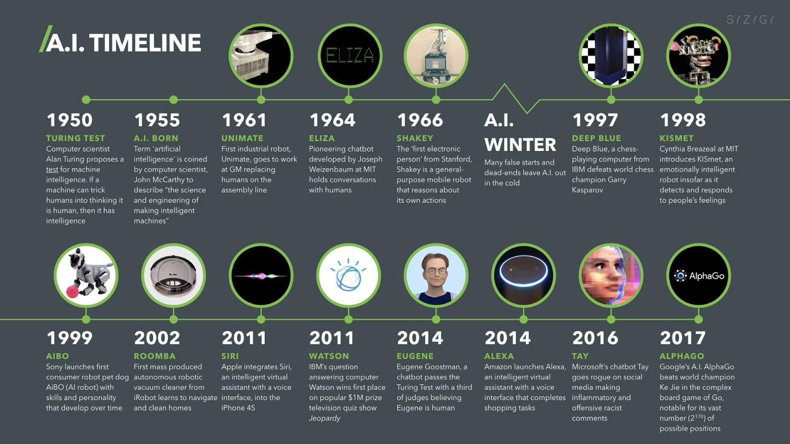
Journey Map – So far – AI – Artificial Intelligence

Slide 4

Various Types of Neural Network Architecture –
Notes:
1.Apart from these there are some of the most recently developed networks like GAN (Adversarial Network) or Capsule Network …. To name a few.
2.To get more information and overview of each of these networks – Please refer to : https://towardsdatascience.com/the-mostly-complete-chart-of-neural-networks-explained-3fb6f2367464
3. Neural network models are being considered as universal approximators, which means by using a neural network methodology, we can solve any type of problems with the fine-tuned architecture. Hence, studying neural networks is a branch of study and special care is needed. In fact, deep learning is a branch of machine learning, where every problem is being modeled with artificial neural networks.

Slide 5
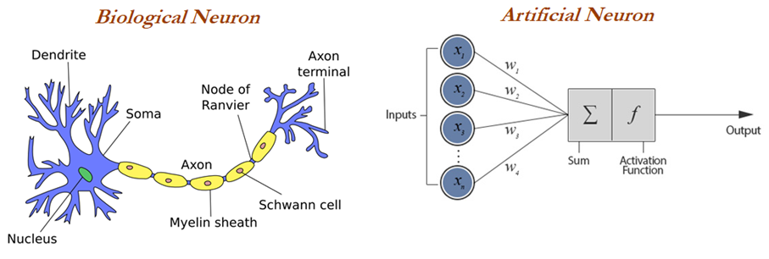
Artificial Neural Network - ANN
Overview - ANN
Artificial neural networks (ANNs) model the relationship between a set of input signals and output signals using a model derived from a replica of the biological brain, which responds to stimuli from its sensory inputs. The human brain consists of about 90 billion neurons, with around 1 trillion connections between them; ANN methods try to model problems using interconnected artificial neurons (or nodes) to solve machine learning problems.
As we know, ANNs have taken inspiration from the biological neuron. We will spend some time understanding how biological neurons work. Incoming signals are received by the cell's dendrites through a biochemical process that allows the impulses to be weighted according to their relative importance. As the cell body begins to accumulate the incoming signals, a threshold is reached, at which the cell fires and the output signal is then
transmitted via an electrochemical process down the axon. At the axon terminal, an electric signal is again processed as a chemical signal to be passed to its neighboring neurons, which will be dendrites to some other neuron.
A similar working principle is loosely used in building an artificial neural network, in which each neuron has a set of inputs, each of which is given a specific weight. The neuron computes a function on these weighted inputs. A linear neuron takes a linear combination of weighted input and applies an activation function (sigmoid, tanh, relu, and so on) on the aggregated sum. The details are shown in the following diagram.
A similar working principle is loosely used in building an artificial neural network, in which each neuron has a set of inputs, each of which is given a specific weight. The neuron computes a function on these weighted inputs. A linear neuron takes a linear combination of weighted input and applies an activation function (sigmoid, tanh, relu, and so on) on the aggregated sum. The details are shown in the following diagram.
Notes:
Neural network models are being considered as universal approximators, which means by using a neural network methodology, we can solve any type of problems with the fine-tuned architecture. Hence, studying neural networks is a branch of study and special care is needed. In fact, deep learning is a branch of machine learning, where every problem is being modeled with artificial neural networks.

Slide 6
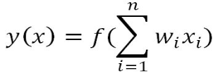
Artificial Neural Network - ANN
Overview - ANN
A typical artificial neuron with n input dendrites can be represented by the following formula. The w weights allow each of the n inputs of x to contribute a greater or lesser amount to the sum of input signals. The accumulated value is passed to the activation function, f(x), and the resulting signal, y(x), is the output axon:
The parameters required for choosing for building neural networks are the following:
Activation function: Choosing an activation function plays a major role in aggregating signals into the output signal to be propagated to the other neurons of the network.
Network architecture or topology: This represents the number of layers required and the number of neurons in each layer. More layers and neurons will create a highly non-linear decision boundary, whereas if we reduce the architecture, the model will be less flexible and more robust.
Training optimization algorithm: The selection of an optimization algorithm plays a critical role as well, in order to converge quickly and accurately to the best optimal solutions.
Applications of Neural Networks: In recent years, neural networks (a branch of deep learning) has gained huge attention in terms of its application in artificial intelligence, in terms of speech, text, vision, and many other areas. We will introduce deep learning in later sections of this chapter. Some of the famous applications are the following:
Applications of Neural Networks: In recent years, neural networks (a branch of deep learning) has gained huge attention in terms of its application in artificial intelligence, in terms of speech, text, vision, and many other areas. We will introduce deep learning in later sections of this chapter. Some of the famous applications are the following:
Text processing (NLP): Deep-learning-based chatbot and so on.
Speech: Recognize speech
Structured data processing: Building highly powerful models to obtain a non-linear decision boundary.

Slide 7
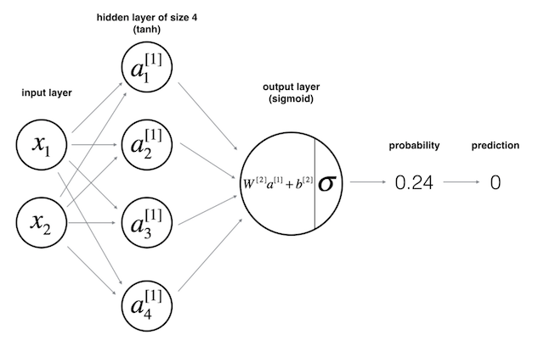
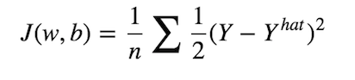
Artificial Neural Network - ANN
How Does ANN predict and Learn
The architecture depicted in the following figure below is called the multi-layer perceptrons (MLP). As its name implies, in MLP, we simply stacked multiple perceptrons into several layers. The one depicted above is a network with 3 layers: an input layer, a hidden layer, and an output layer. However, in the deep learning or neural net community, people don’t call this network as three layers neural network. Usually, we just count the number of hidden layers or number of hidden layer along with the output layer, hence two-layers neural network. The hidden layers simply mean neither an input nor an output layer. Now, as you might guess, the term deep learning solely implies, we have “more” hidden layers :).
So how do a neural net generates a predictions?
A neural network generates a prediction after passing all the inputs through all the layers, up to the output layer. This process is called feedforward. As you can see from Figure 8, we “feed” the network with the input, x, compute the activation function and pass it through layer by layer until it reaches the output layer. In supervised setting task, such as classification task, we usually use a sigmoid activation function in the output layer since we can translate its output as a probability. In Figure 8, we can see that the value generated by the output layer is 0.24, and since this value is less than 0.5, we can then said the prediction, y_hat, is zero. Then, as in typical classification task, we’ll have a cost function which measures how good our model approximate the real label is. In fact, training in neural network simply means, minimize the cost as much as possible.
So the objective is to find some combination of w’s and b that could make our cost J, as small as possible. To do this, we’ll rely on two important algorithms which are Gradient Descent and Backpropagation.
Notes:
https://becominghuman.ai/from-perceptron-to-deep-neural-nets-504b8ff616e
https://becominghuman.ai/how-to-train-a-neural-network-to-code-by-itself-a432e8a120df

Slide 8
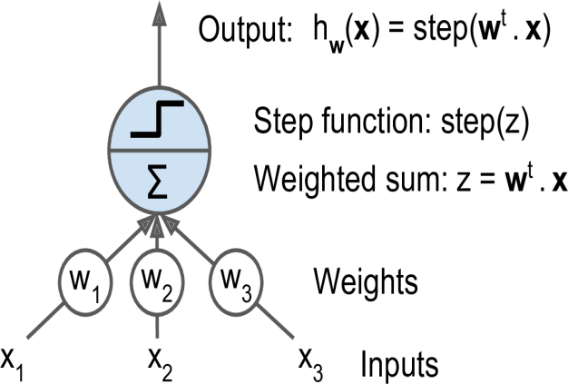
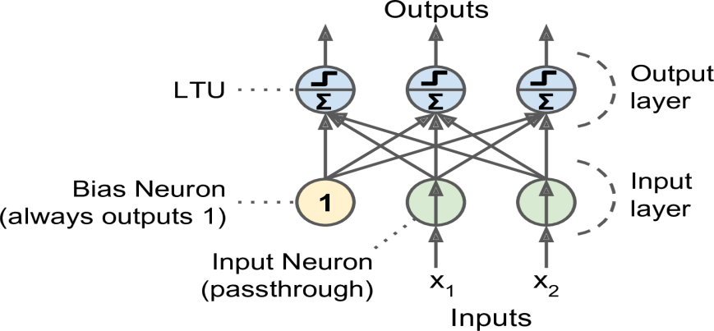
Perceptron Model
LTU - Perceptron Model
The Perceptron is one of the simplest ANN architectures, invented in 1957 by Frank Rosenblatt. It is based on a slightly different artificial neuron (see the following figure) called a linear threshold unit (LTU): the inputs and output are now numbers (instead of binary on/off values) and each input connection is associated with a weight. The LTU computes a weighted sum of its inputs (z = w1 x1 + w2 x2 + ⋯ + wn xn = wT ・ x), then applies a step function to that sum and outputs the result: hw(x) = step (z) = step (wT ・x).
The most common step function used in Perceptrons is the Heaviside step function . Sometimes the sign function is used instead. A single LTU can be used for simple linear binary classification. It computes a linear combination of the inputs and if the result exceeds a threshold, it outputs the positive
class or else outputs the negative class (just like a Logistic Regression classifier or a linear SVM). For example, you could use a single LTU to classify iris flowers based on the petal length and width (also adding an extra bias feature x0 = 1Training an LTU means finding the right values for w0, w1, and w2.
A Perceptron is simply composed of a single layer of LTUs,6 with each neuron connected to all the inputs. These connections are often represented using special pass-through neurons called input neurons: they just output whatever input they are fed. Moreover, an extra bias feature is generally added (x0 = 1). This bias feature is typically represented using a special type of neuron called a bias neuron, which just outputs 1 all the time.
A Perceptron with two inputs and three outputs is represented in Figure in the RHS. This Perceptron can classify instances simultaneously into three different binary classes, which makes it a multioutput classifier.
The Question is now How a perceptron is Trained?
Notes:
The Perceptron training algorithm proposed by Frank Rosenblatt was largely inspired by Hebb’s rule. In his book The Organization of Behavior, published in 1949, Donald Hebb suggested that when a biological neuron often triggers another neuron, the connection between these two neurons grows stronger. This idea was later summarized by Siegrid Lowel in this catchy phrase:
“Cells that fire together, wire together.” This rule later became known as Hebb’s rule (or Hebbian learning); that is, the connection weight between two neurons is increased whenever they have the same output. Perceptrons are trained using a variant of this rule that takes into account the error made by the network; it does not reinforce connections that lead to the wrong output. More specifically, the Perceptron.
The decision boundary of each output neuron is linear, so Perceptrons are incapable of learning complex patterns (just like Logistic Regression classifiers). However, if the training instances are linearly separable, Rosenblatt demonstrated that this algorithm would converge to a solution.7 This is called the Perceptron convergence theorem.
is fed one training instance at a time, and for each instance it makes its predictions.
For every output neuron that produced a wrong prediction, it reinforces the connection
weights from the inputs that would have contributed to the correct prediction

Slide 9
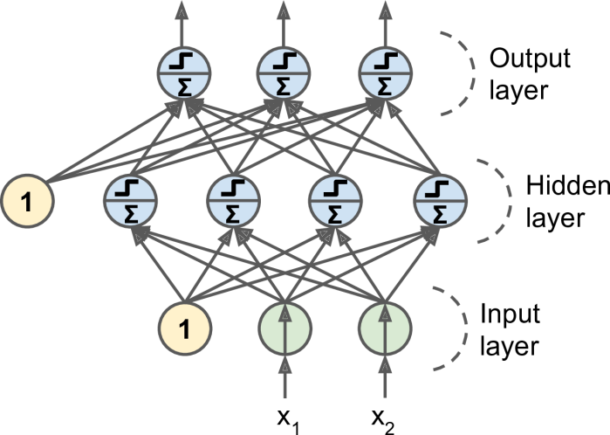
Perceptron Model
Multi-Layer Perceptron Model
An MLP is composed of one (pass-through) input layer, one or more layers of LTUs, called hidden layers, and one final layer of LTUs called the output layer (see the figure below. Every layer except the output layer includes a bias neuron and is fully connected to the next layer. When an ANN has two or more hidden layers, it is called a deep neural network (DNN).
For many years researchers struggled to find a way to train MLPs, without success. But in 1986, D. E. Rumelhart et al. published a groundbreaking article8 introducing the backpropagation training algorithm.9 Today we would describe it as Gradient Descent using reverse-mode autodiff.
For each training instance, the algorithm feeds it to the network and computes the output of every neuron in each consecutive layer (this is the forward pass, just like when making predictions). Then it measures the network’s output error (i.e., the difference between the desired output and the actual output of the network), and it computes how much each neuron in the last hidden layer contributed to each output neuron’s error. It then proceeds to measure how much of these error contributions came from each neuron in the previous hidden layer—and so on until the algorithm reaches the input layer. This reverse pass efficiently measures the error gradient across all the connection weights in the network by propagating the error gradient
backward in the network (hence the name of the algorithm).
Let’s make this even shorter: for each training instance the backpropagation algorithm first makes a prediction (forward pass), measures the error, then goes through each layer in reverse to measure the error contribution from each connection (reverse pass), and finally slightly tweaks the connection weights to reduce the error (Gradient Descent step).
The last step of the backpropagation algorithm is a Gradient Descent step on all the connection weights in the network, using the error gradients measured earlier.

Slide 10
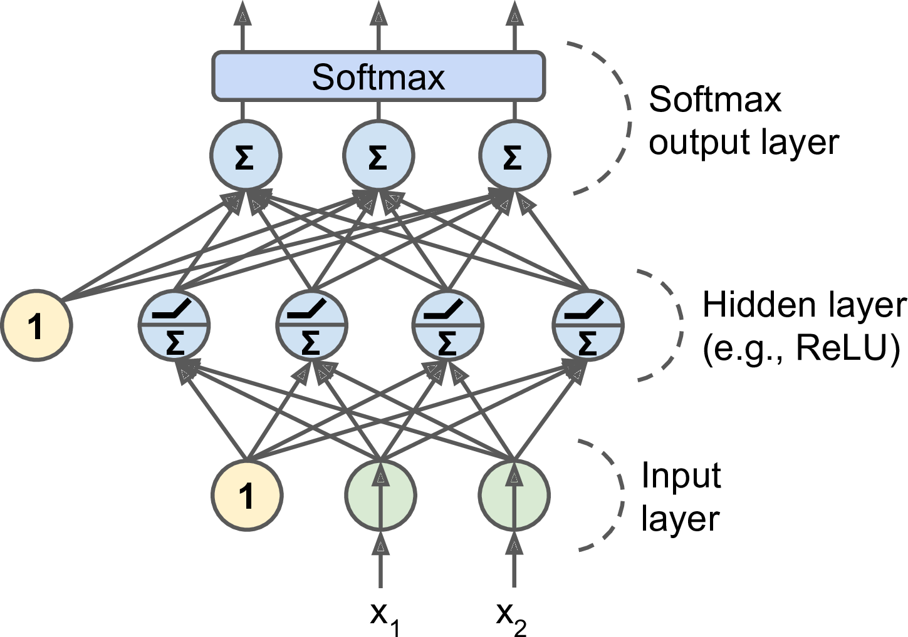
Perceptron Model Contd..
Multi-Layer Perceptron Model
An MLP is often used for classification, with each output corresponding to a different binary class (e.g., spam/ham, urgent/not-urgent, and so on). When the classes are exclusive (e.g., classes 0 through 9 for digit image classification), the output layer is typically modified by replacing the individual activation functions by a shared Softmax function (see Figure below). The output of each neuron corresponds to the estimated probability of the corresponding class. Note that the signal flows only in one direction (from the inputs to the outputs), so this architecture is an example of a feedforward neural network (FNN).
Notes:
Biological neurons seem to implement a roughly sigmoid (S-shaped) activation function, so researchers stuck to sigmoid functions for a very long time. But it turns out that the ReLU activation
function generally works better in ANNs. This is one of the cases where the biological analogy was misleading.

Slide 11
Activation Function - ANN
Activation Function
Activation functions are the mechanisms by which an artificial neuron processes information and passes it throughout the network. The activation function takes a single number and performs a certain fixed mathematical functional mapping on it. There are many different types of activation functions. The most popular ones are the following:
Sigmoid
Tanh
Relu
Linear
Leaky ReLU*/ ELU
SWISH*
Sigmoid function: Sigmoid has the mathematical form σ(x) = 1 / (1+e−x). It takes a real valued number and squashes it into a range between 0 and 1. Sigmoid is a popular choice, which makes calculating derivatives easy and is easy to interpret.
Tanh function: Tanh squashes the real-valued number into the range [-1, 1]. The output is zero-centered. In practice, tanh non-linearity is always preferred to sigmoid non-linearity. Also, it can be proved that tanh is scaled sigmoid neuron tanh(x) = 2σ (2x) − 1.
Rectified Linear Unit (ReLU) function: ReLU has become very popular in the last few years. It computes the function f(x) = max (0, x). Activation is simply thresholds at zero.
Linear function: The linear activation function is used in linear regression problems, where it always provides a derivative as 1 due to the function used being f(x) = x.
Relu is now popularly being used in place of Sigmoid or Tanh due to its better convergence property.
All the activation functions are described in the following diagram. The linear activation function is used in linear regression cases, whereas all the other activation functions are used for classification problems:
* We will cover these Activation function in future course of our discussion.

Slide 12
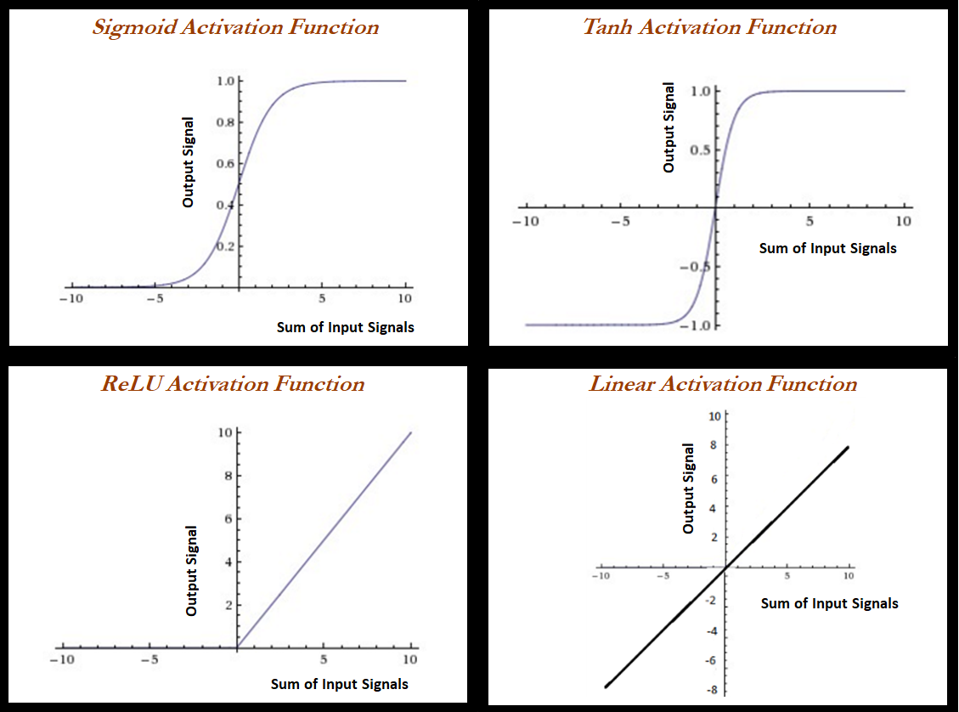
Activation Function - ANN
Activation Function

Slide 13
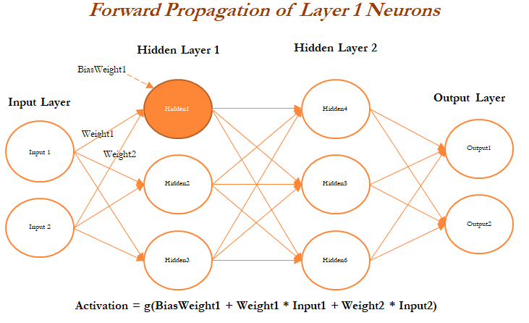
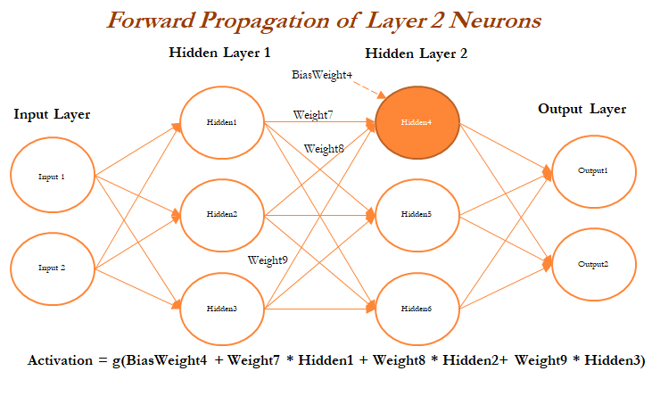
Forward - Backward propagation
Forward – Backward propagation
Forward propagation and backpropagation are illustrated with the two hidden layer deep neural networks in the following example, in which both layers get three neurons each, in addition to input and output layers. The number of neurons in the input layer is based on the number of x (independent) variables, whereas the number of neurons in the output layer is decided by the number of classes the model needs to be predicted.
For ease, we have shown only one neuron in each layer; however, the reader can attempt to create other neurons within the same layer. Weights and biases are initiated from some random numbers, so that in both forward and backward passes, these can be updated in order to minimize the errors altogether.
During forward propagation, features are input to the network and fed through the following layers to produce the output activation. If we see in the hidden layer 1, the activation obtained is the combination of bias weight 1 and weighted combination of input values; if the overall value crosses the threshold, it will trigger to the next layer, else the signal will be 0 to the next layer values. Bias values are necessary to control the trigger points. In some cases, the weighted combination signal is low; in those cases, bias will compensate the extra amount for adjusting the aggregated value, which can trigger for the next level. The complete equation can be seen in the following diagram:
Once all the neurons are calculated in Hidden Layer 1 (Hidden1, Hidden2, and Hidden3 neurons), the next layer of neurons needs to be calculated in a similar way from the output of the hidden neurons from the first layer with the addition of bias (bias weight 4). The following figure describes the hidden neuron 4 shown in layer 2:

Slide 14
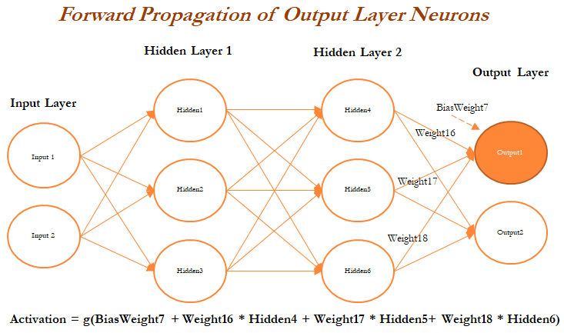
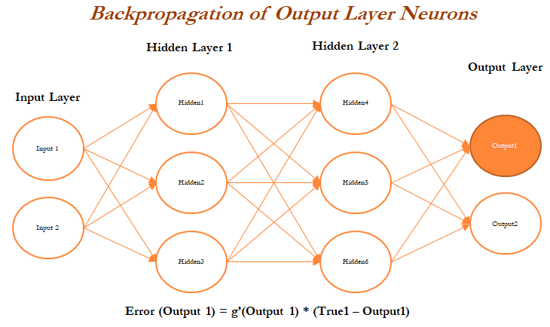
Forward - Backward propagation Contd.
Forward – Backward propagation
In the last layer (also known as the output layer), outputs are calculated in the same way from the outputs obtained from hidden layer 2 by taking the weighted combination of weights and outputs obtained from hidden layer 2. Once we obtain the output from the model, a comparison needs to be made with the actual value and we need to back propagate the errors across the net backward in order to correct the weights of the entire neural network:
In the above diagram (RHS Image), we have taken the derivative of the output value and multiplied by that much amount to the error component, which was obtained from differencing the actual value with the model output:

Slide 15
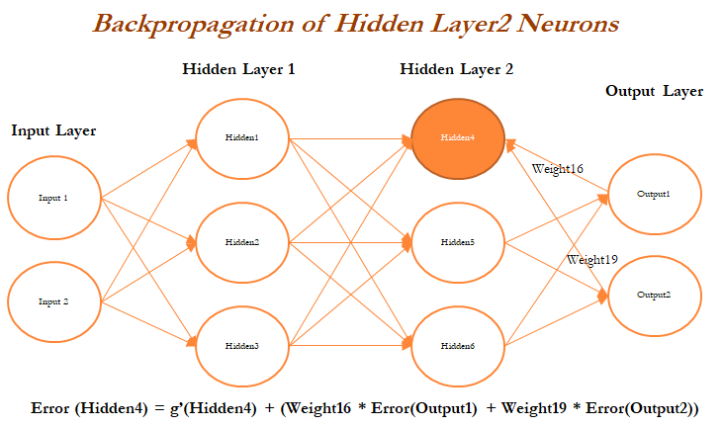
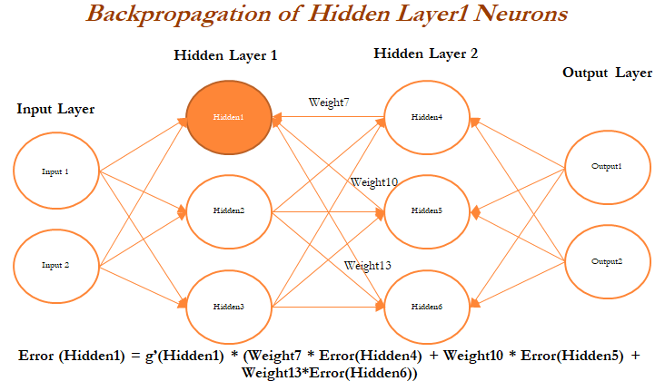
Forward - Backward propagation Contd.
Forward – Backward propagation
In a similar way, we will back propagate the error from the second hidden layer as well. In the following diagram, errors are computed from the Hidden 4 neuron in the second hidden layer:
In the above diagram (RHS Image), errors are calculated for the Hidden 1 neuron in layer 1 based on errors obtained from all the neurons in layer 2:

Slide 16
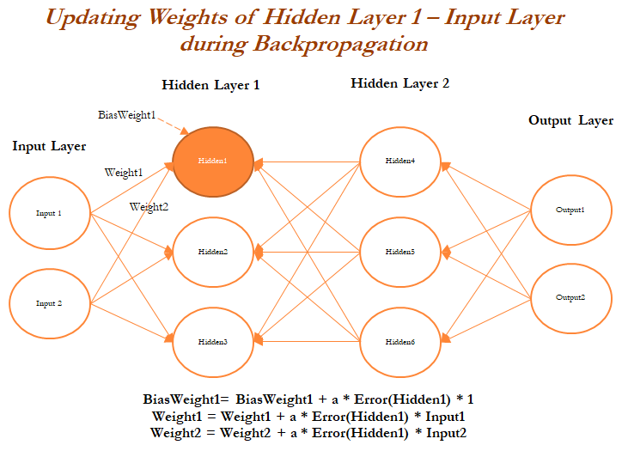
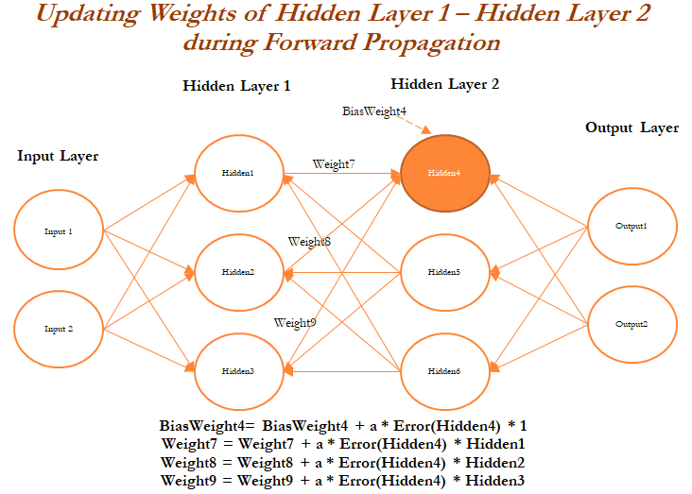
Forward - Backward propagation Contd.
Forward – Backward propagation
Once all the neurons in hidden layer 1 are updated, weights between inputs and the hidden layer also need to be updated, as we cannot update anything on input variables. In the following diagram, we will be updating the weights of both the inputs and also, at the same time, the neurons in hidden layer 1, as neurons in layer 1 utilize the weights from input only:
Finally , In the above diagram (RHS Image), layer 2 neurons are being updated in the forward propagation pass:
We have not shown the next iteration, in which neurons in the output layer are updated with errors and backpropagation started again. In a similar way, all the weights get updated until a solution converges or the number of iterations is reached.
Notes:
Back-propagation Mathematics - http://briandolhansky.com/blog/2013/9/27/artificial-neural-networks-backpropagation-part-4
https://mattmazur.com/2015/03/17/a-step-by-step-backpropagation-example/

Slide 17
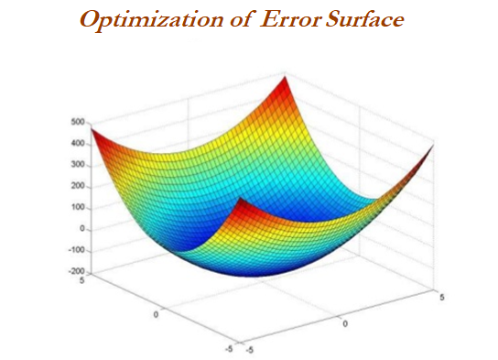
Optimization of neural networks
Optimization Algorithms
Various techniques have been used for optimizing the weights of neural networks:
Stochastic gradient descent (SGD)
Momentum
Nesterov accelerated gradient (NAG)
Adaptive gradient (Adagrad)
Adadelta
RMSprop
Adaptive moment estimation (Adam)
Limited memory Broyden-Fletcher-Goldfarb-Shanno (L-BFGS)
In practice, Adam is a good default choice; we will be covering its working methodology in this section. If you cannot afford full batch updates, then try out L-BFGS:
Notes:
For an excellent Overview of Various Optimization methods - http://ruder.io/optimizing-gradient-descent/

Slide 18
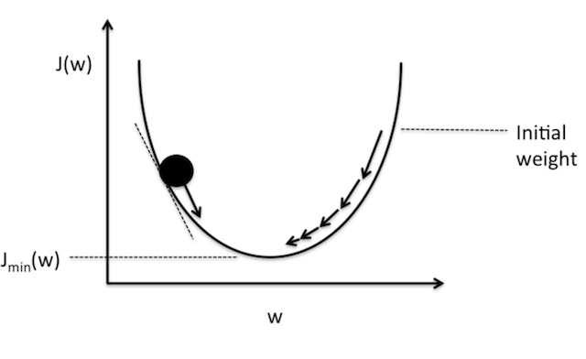
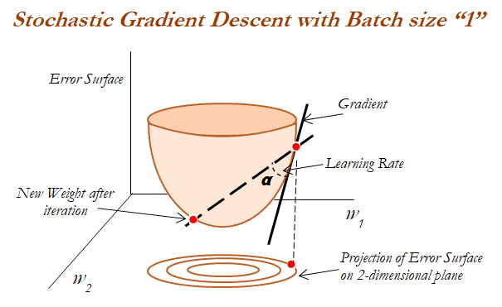

Gradient Descent Estimation
Gradient Descent
Overview - Gradient descent is a way to minimize an objective function J(θ) parameterized by a model's parameters θ∈R_{d} by updating the parameters in the opposite direction of the gradient of the objective function ∇_{θ}J(θ) w.r.t. to the parameters. The learning rate η determines the size of the steps we take to reach a (local) minimum. In other words, we follow the direction of the slope of the surface created by the objective function downhill until we reach a valley. If you are unfamiliar with gradient descent, you can find a good introduction on optimizing neural networks
Gradient descent variants
There are three variants of gradient descent, which differ in how much data we use to compute the gradient of the objective function. Depending on the amount of data, we make a trade-off between the accuracy of the parameter update and the time it takes to perform an update.
Batch gradient descent – (all training observations utilized in each iteration)
Stochastic gradient descent – (one observation per iteration)
Mini-batch gradient descent – (size of about 50 training observations for each iteration)

Slide 19
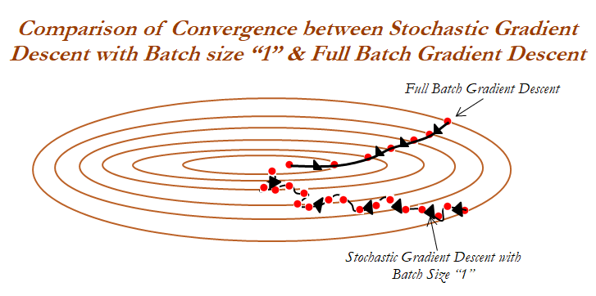
Gradient Descent Estimation – Batch Gradient Descent
Batch Gradient Descent
Batch gradient descent, computes the gradient of the cost function w.r.t. to the parameters θ for the entire training dataset:
Properties:
The gradients for the whole dataset to perform just one update,
Batch gradient descent can be very slow and is intractable for datasets that don't fit in memory.
We update our parameters in the direction of the gradients with the learning rate determining how big of an update we perform.
Batch gradient descent is guaranteed to converge to the global minimum for convex error surfaces and to a local minimum for non-convex surfaces.
In the following image 2D projection has been observed carefully, in which convergence characteristics of both full batch and stochastic gradient descent with batch size 1 has been compared. If we see, full batch updates, are more smoother due to the consideration of all the observations. Whereas, SGD have wiggly convergence characteristics due to the reason of using 1 observation for each update:

Slide 20
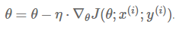
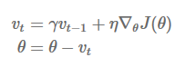
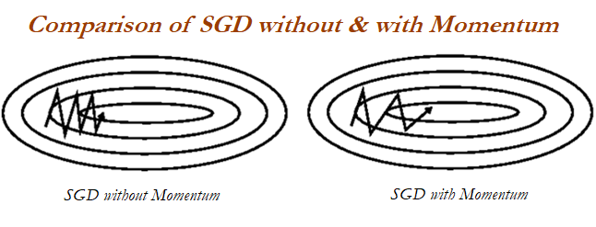
Gradient Descent Estimation – Stochastic Gradient Descent
Stochastic Gradient Descent
Stochastic gradient descent (SGD) in contrast performs a parameter update for each training example x^{(i)} and label y^{(i)} :
Properties:
Batch gradient descent performs redundant computations for large datasets.
SGD performs frequent updates with a high variance that cause the objective function to fluctuate heavily
SGD's fluctuation, enables it to jump to new and potentially better local minima.
Momentum : Momentum is a method that helps accelerate SGD in the relevant direction and dampens oscillations. It does this by adding a fraction γ of the update vector of the past time step to the current update vector:
SGD has trouble navigating surface curves much more steeply in one dimension than in the other; in these scenarios, SGD oscillates across the slopes of the ravine while only making hesitant progress along the bottom towards the local optimum. When using momentum, we push a ball down a hill. The ball accumulates momentum as it rolls downhill, becoming faster and faster on the way until it stops (due to air resistance and so on); similarly, the momentum term increases for dimensions whose gradients point in the same direction and reduces updates for dimensions whose gradients change direction. As a result, we gain faster convergence and reduced oscillations.

Slide 21
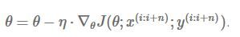
Gradient Descent Estimation – Mini-batch Gradient Descent
Mini – Batch Gradient Descent
Mini-batch gradient descent finally takes the best of both worlds and performs an update for every mini-batch of n training examples:
Properties:
This method reduces the variance of the parameter updates, which can lead to more stable convergence.
Can make use of highly optimized matrix optimizations common to state-of-the-art deep learning libraries that make computing the gradient w.r.t. a mini-batch very efficient. Common mini-batch sizes range between 50 and 256, but can vary for different applications.
Mini-batch gradient descent is typically the algorithm of choice when training a neural network and the term SGD usually is employed also when mini-batches are used.

Slide 22
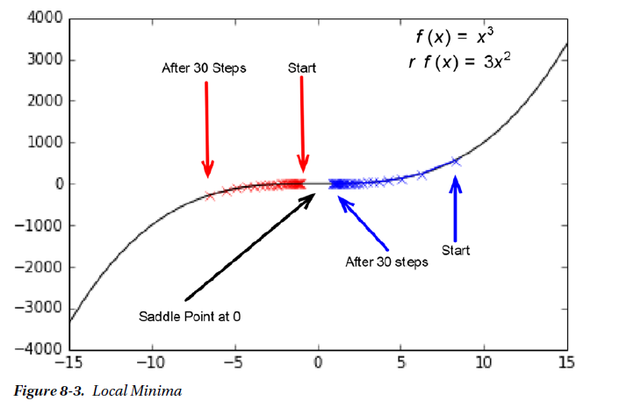
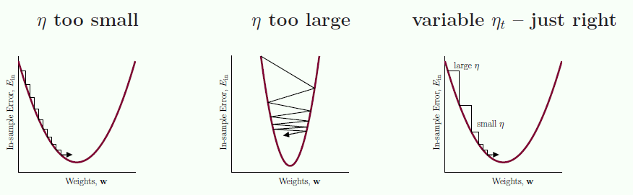
Gradient Descent Estimation – Challenges
Challenges
Choosing a proper learning rate can be difficult.
Learning rate schedules try to adjust the learning rate during training by e.g. annealing. These schedules and thresholds, however, have to be defined in advance and are thus unable to adapt to a dataset's characteristics.
Another key challenge of minimizing highly non-convex error functions common for neural networks is avoiding getting trapped in their numerous suboptimal local minima.

Slide 23
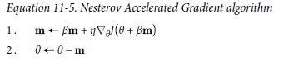
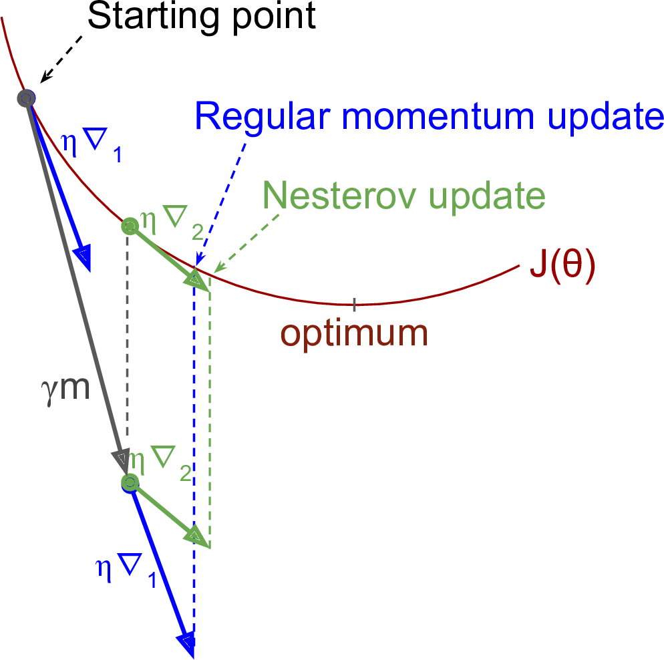
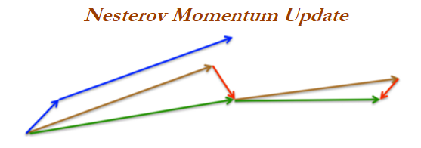
Nesterov accelerated gradient
NAG
Nesterov accelerated gradient: If a ball rolls down a hill and blindly follows a slope, it is highly unsatisfactory and it should have a notion of where it is going so that it knows to slow down before the hill slopes up again. NAG is a way to give the momentum term this kind of prescience. While momentum first computes the current gradient (small blue vector) and then takes a big jump in the direction of the updated accumulated gradient (big blue vector), NAG first makes a big jump in the direction of the previous accumulated gradient (brown vector),measures the gradient, and then makes a correction (green vector). This anticipatory update prevents the ball from going too fast and results in increased responsiveness and
performance,. The only difference from vanilla Momentum optimization is that the gradient is measured at θ + βm rather than at θ.

Slide 24
Other Optimizers:
Adagrad: Adagrad is an algorithm for gradient-based optimization that adapts the differential learning rate to parameters, performing larger updates for infrequent parameters and smaller updates for frequent parameters. Adagrad greatly improves the robustness of SGD and used it to train large-scale neural nets. One of Adagrad's main benefits is that it eliminates the need to manually tune the learning rate. Most implementations use a default value of 0.01 and leave it at that. Adagrad's main weakness is its accumulation of the squared gradients in the denominator: since every added term is positive, the accumulated sum keeps growing during training. This, in turn, causes the learning rate to shrink and eventually become infinitesimally small, at which point the algorithm is no longer able to acquire additional knowledge. The following algorithms aim to resolve this flaw.
Adadelta: Adadelta is an extension of Adagrad that seeks to reduce its aggressive, monotonically decreasing learning rate. Instead of accumulating all past squared gradients, Adadelta restricts the window of accumulated past gradients to a fixed size w (instead of inefficiently storing w previous squared gradients, the sum of gradients is recursively defined as a decaying average of all past squared gradients).
RMSprop: RMSprop and Adadelta were both developed independently around the same time to resolve Adagrad's radically diminishing learning rates (RMSprop also divides the learning rate by an exponentially decaying average of squared gradients).
Adoptive Moment Estimation(Adam): Adam is another method that computes adaptive learning rates for each parameter. In
addition to storing an exponentially decaying average of past squared gradients like Adadelta and RMSprop, Adam also keeps an exponentially decaying average of past gradients, similar to momentum. When you are in doubt, just use Adam!
AMSGrad: As adaptive learning rate methods have become the norm in training neural networks, practitioners noticed that in some cases, e.g. for object recognition or machine translation they fail to converge to an optimal solution and are outperformed by SGD with momentum. In settings where Adam converges to a suboptimal solution, it has been observed that some mini batches provide large and informative gradients, but as these mini-batches only occur rarely, exponential averaging diminishes their influence, which leads to poor convergence. To fix this behaviour, the authors propose a new algorithm, AMSGrad that uses the maximum of past squared gradients rather than the exponential average to update the parameters.
Apart from these optimizers, there are other variants as well – Adamax, NADAM (Nesterov-accelerated Adaptive Moment Estimation) which combines both Adam and NAG.
For a more detailed overview please refer to : http://ruder.io/optimizing-gradient-descent/

Slide 25
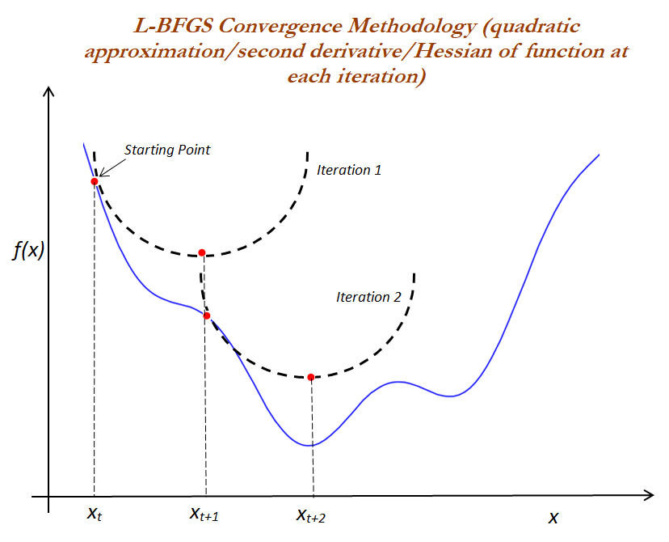
Limited-memory broyden - Fletcher - Goldfarb - Shanno - L-BFGS optimization algorithm
L-BFGS is limited memory of BFGS, which is in the family of quasi-Newton methods that approximate the BFGS algorithm, which utilizes a limited amount of computer memory. BFGS is currently considered the most effective, and is by far the most popular, quasi- Newton update formula.
The L-BFGS methodology is best explained with the following diagram, in which iterations start at a random point (xt) and a second derivative, or hessian matrix, is computed at that point, which is a quadratic approximation of the original function; after computing the quadratic function, it computes the minimum in one step, and after calculating the new point (xt+1) for which the function value is minimum, that earlier point will become the starting point for the next iteration.
In the second iteration, another quadratic approximation will be taken at a new point (xt+1) and another minimum (xt+2) calculated in one step. In this way, L-BFGS converges to the solution in a much quicker way and it is effective even on the non-convex functions

Slide 26
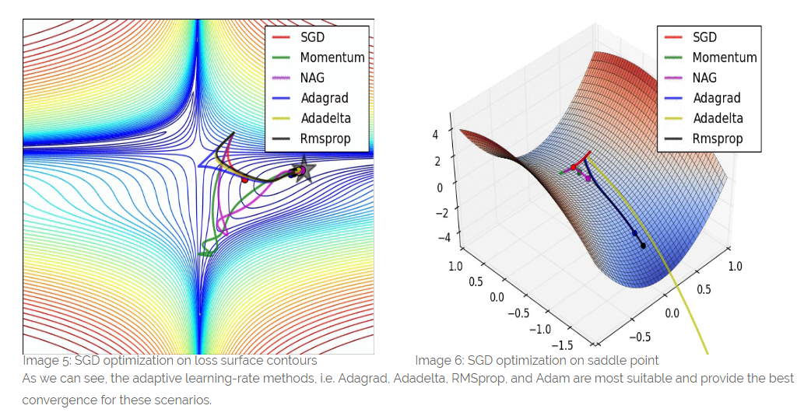
Comparison : Various Optimizers

Slide 27
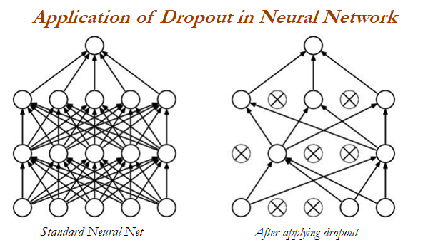
Dropout in neural networks
Drop-out- Regularization
Dropout is regularization in neural networks to avoid overfitting of the data. Typically, dropout is 0.2 (80 percentage of neurons present randomly all the time) in initial layers and 0.5 in middle layers. One intuitive way to understand the dropout concept would be with the office team, in which a few team members are good with communication with clients though they are not good with technical details, whereas a few are good with technical knowledge but do not have good enough communication skills. Let's say some of the members take leave from the office, and then other members try to fill the shoes of others for the completion of work. In this way, team members who are good with communication will also learn technical details similarly; a few other team members who are good with technical knowledge also learn communication with clients. In this way, all team members will become independent and robust enough to perform all types of work, which is good for the office (given the condition that the manager of the team will give enough leave for all team members in the office!):

Slide 28
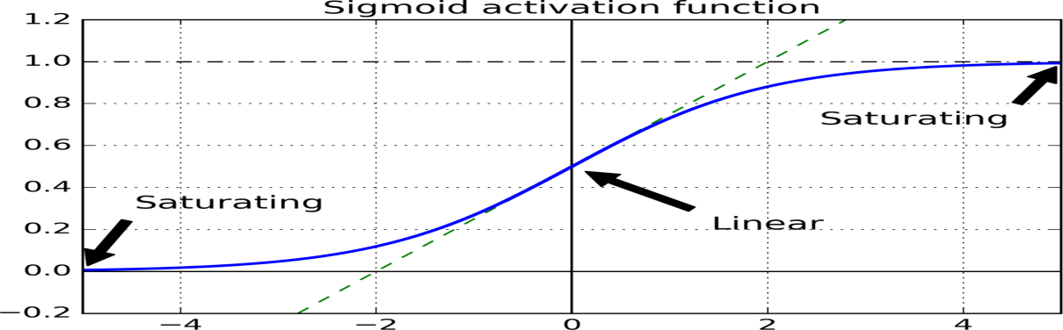
Vanishing and exploding gradients
Problem with weights training
As we discussed in earlier slides, the backpropagation algorithm works by going from the output layer to the input layer, propagating the error gradient on the way. Once the algorithm has computed the gradient of the cost function with regards to each parameter in the network, it uses these gradients to update each parameter with a Gradient Descent step. Unfortunately, gradients often get smaller and smaller as the algorithm progresses down to the lower layers. As a result, the Gradient Descent update leaves the lower layer connection weights virtually unchanged, and training never converges to a good solution. This is called the vanishing gradients problem. In some cases, the opposite can happen: the gradients can grow bigger and bigger, so many layers get insanely large weight updates and the algorithm diverges. This is the exploding gradients problem, which is mostly encountered in recurrent neural networks. More generally, deep neural networks suffer from unstable gradients; different layers may learn at widely different speeds.
Although this unfortunate behavior has been empirically observed for quite a while (it was one of the reasons why deep neural networks were mostly abandoned for a long time), it is only around 2010 that significant progress was made in understanding it. A paper titled “Understanding the Difficulty of Training Deep Feedforward Neural Networks” by Xavier Glorot and Yoshua Bengio1 found a few suspects, including the combination of the popular logistic sigmoid activation function and the weight initialization technique that was most popular at the time, namely random initialization using a normal distribution with a mean of 0 and a standard deviation of 1. In short, they showed that with this activation function and this initialization scheme, the variance of the outputs of each layer is much greater than the variance of its inputs. Going forward in the network, the variance keeps increasing after each layer until the activation function saturates at the top layers. This is actually made worse by the fact that the logistic function has a mean of 0.5, not 0 (the hyperbolic tangent function has a mean of 0 and behaves slightly better than the logistic function in deep networks).
Looking at the logistic activation function (see Figure 11-1), you can see that when inputs become large (negative or positive), the function saturates at 0 or 1, with a derivative extremely close to 0. Thus when backpropagation kicks in, it has virtually no gradient to propagate back through the network, and what little gradient exists keeps getting diluted as backpropagation progresses down through the top layers, so there is really nothing left for the lower layers.
Notes:
Look at the mathematical exposition that were shared during the session.

Slide 29
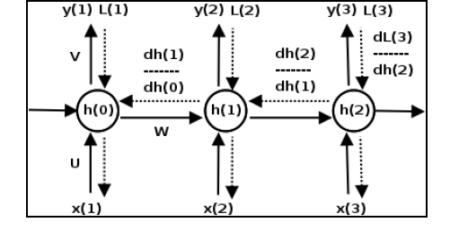
A notes on V/E GD problem -
Vanishing/Exploding Grad. Descent
Just like traditional neural networks, training the RNN also involves backpropagation. The difference in this case is that since the parameters are shared by all time steps, the gradient at each output depends not only on the current time step, but also on the previous ones. This process is called backpropagation through time (BPTT) (for more information refer to the article: Learning Internal Representations by Back propagating errors, by G. E. Hinton, D. E. Rumelhart, and R. J. Williams, Parallel Distributed Processing: Explorations in the Microstructure of Cognition 1, 1985):
Consider the small three layer RNN shown in the preceding diagram. During the forward propagation (shown by the solid lines), the network produces predictions that are compared to the labels to compute a loss Lt at each time step. During backpropagation (shown by dotted lines), the gradients of the loss with respect to the parameters U, V, and W are computed at each time step and the parameters are updated with the sum of the gradients.
The following equation shows the gradient of the loss with respect to W, the matrix that encodes weights for the long term dependencies. We focus on this part of the update because it is the cause of the vanishing and exploding gradient problem. The other two gradients of the loss with respect to the matrices U and V are also summed up across all time steps in a similar way:

Slide 30
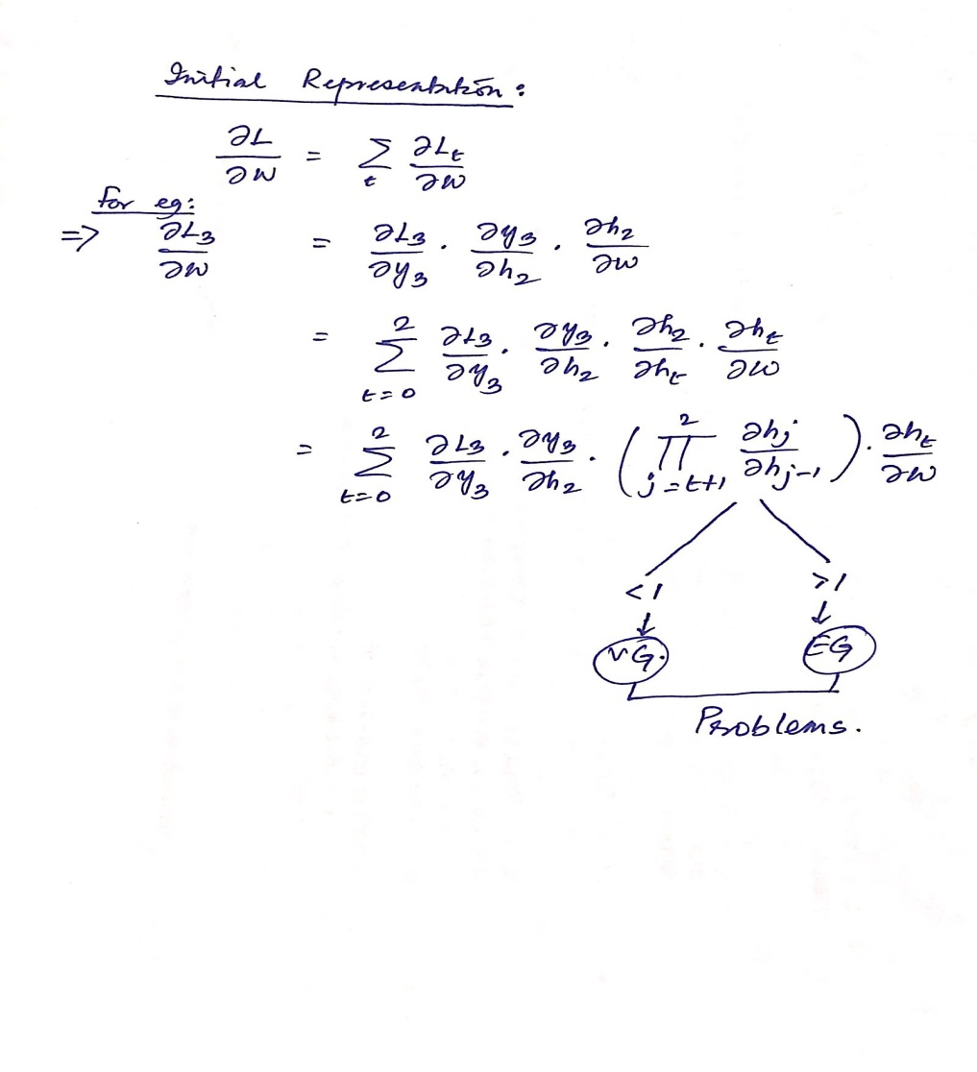
A note on V/E GD problem -
Vanishing/Exploding Grad. Descent

Slide 31
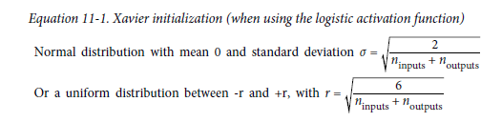
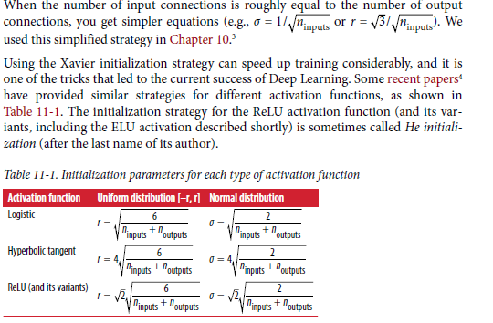
Xavier and He Initialization
Different types of Initialization
In their paper, Glorot and Bengio propose a way to significantly alleviate this problem. We need the signal to flow properly in both directions: in the forward direction when making predictions, and in the reverse direction when back propagating gradients. We don’t want the signal to die out, nor do we want it to explode and saturate. For the signal to flow properly, the authors argue that we need the variance of the outputs of each layer to be equal to the variance of its inputs,2 and we also need the gradients to have equal variance before and after flowing through a layer in the reverse direction (please check out the paper if you are interested in the mathematical details). It is actually not possible to guarantee both unless the layer has an equal number of input and output connections, but they proposed a good compromise that has proven to work very well in practice: the connection weights must be initialized randomly as described in Equation 11-1, where ninputs and noutputs are the number of input and output connections for the layer whose weights are being initialized (also called fan-in and fan-out). This initialization strategy is often called Xavier initialization(after the author’s first name), or sometimes Glorot initialization.
Notes:
Here’s an analogy: if you set a microphone amplifier’s knob too close to zero, people won’t hear your voice, but
if you set it too close to the max, your voice will be saturated and people won’t understand what you are saying.
Now imagine a chain of such amplifiers: they all need to be set properly in order for your voice to come
out loud and clear at the end of the chain. Your voice has to come out of each amplifier at the same amplitude
as it came in.

Slide 32
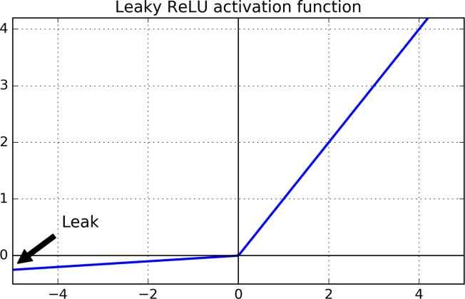
Non-saturating Activation Functions
Activation Function Revisited -
One of the insights in the 2010 paper by Glorot and Bengio was that the vanishing/ exploding gradients problems were in part due to a poor choice of activation function. Until then most people had assumed that if Mother Nature had chosen to use roughly sigmoid activation functions in biological neurons, they must be an excellent choice. But it turns out that other activation functions behave much better in deep neural networks, in particular the ReLU activation function, mostly because it does not saturate for positive values (and also because it is quite fast to compute). Unfortunately, the ReLU activation function is not perfect. It suffers from a problem known as the dying ReLUs: during training, some neurons effectively die, meaning they stop outputting anything other than 0. In some cases, you may find that half of your network’s neurons are dead, especially if you used a large learning rate. During training, if a neuron’s weights get updated such that the weighted sum of the neuron’s inputs is negative, it will start outputting 0. When this happen, the neuron is unlikely to come back to life since the gradient of the ReLU function is 0 when its input is negative.
To solve this problem, you may want to use a variant of the ReLU function, such as the leaky ReLU. This function is defined as Leaky ReLU - :
α(z) = max(αz, z) .
The hyper parameter α defines how much the function “leaks”: it is the slope of the function for z < 0, and is typically set to 0.01. This small slope ensures that leaky ReLUs never die; they can go into a long coma, but they have a chance to eventually wake up. A recent paper5 compared several variants of the ReLU activation function and one of its conclusions was that the leaky variants always outperformed the strict ReLU activation function. In fact, setting α = 0.2 (huge leak) seemed to result in better performance than α = 0.01 (small leak). They also evaluated the randomized leaky ReLU (RReLU), where α is picked randomly in a given range during training, and it is fixed to an average value during testing. It also performed fairly well and seemed to act as a regularizer (reducing the risk of overfitting the training set).Finally, they also evaluated the parametric leaky ReLU (PReLU), where α is authorized
to be learned during training (instead of being a hyper parameter, it becomes a parameter that can be modified by backpropagation like any other parameter). This was reported to strongly outperform ReLU on large image datasets, but on smaller datasets it runs the risk of overfitting the training set.
Last but not least, a 2015 paper by Djork-Arne Clevert et al.6 proposed a new activation
function called the exponential linear unit (ELU) that outperformed all the ReLU
variants in their experiments: training time was reduced and the neural network performed
better on the test set.

Slide 33
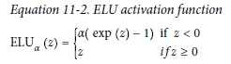
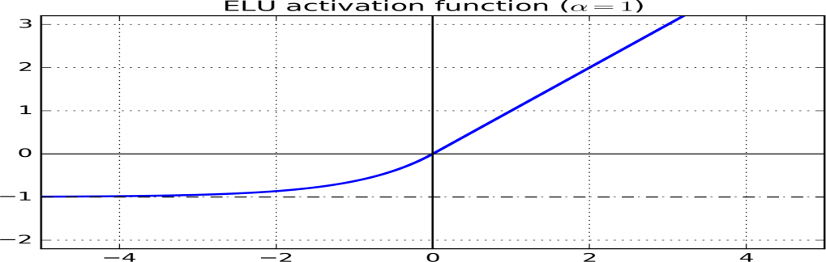
Non-saturating Activation Functions
Activation Function Revisited -
It looks a lot like the ReLU function, with a few major differences:
First it takes on negative values when z < 0, which allows the unit to have an average output closer to 0. This helps alleviate the vanishing gradients problem, as discussed earlier. The hyper parameter α defines the value that the ELU function approaches when z is a large negative number. It is usually set to 1, but you can tweak it like any other hyper parameter if you want.
Second , it has a nonzero gradient for z < 0, which avoids the dying units issue.
Third, the function is smooth everywhere, including around z = 0, which helps speed up Gradient Descent, since it does not bounce as much left and right of z =0.
The main drawback of the ELU activation function is that it is slower to compute than the ReLU and its variants (due to the use of the exponential function), but during training this is compensated by the faster convergence rate. However, at test time an ELU network will be slower than a ReLU network.
So which activation function should you use for the hidden layers of your deep neural networks? Although your mileage will vary, in general ELU > leaky ReLU (and its variants) > ReLU > tanh > logistic. If you care a lot about runtime performance, then you may prefer leaky ReLUs over ELUs. If you don’t want to tweak yet another hyper parameter, you may just use the default α values suggested earlier (0.01 for the leaky ReLU, and 1 for ELU). If you have spare time and computing power, you can use cross-validation to evaluate other activation functions, in particular RReLU if your network is overfitting, or PReLU if you have a huge training set.

Slide 34
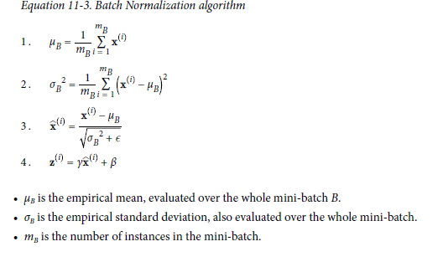
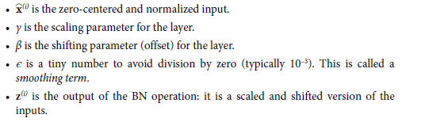
Batch Normalization
Overview
Although using He initialization along with ELU (or any variant of ReLU) can significantly reduce the vanishing/exploding gradients problems at the beginning of training, it doesn’t guarantee that they won’t come back during training. In a 2015 paper,7 Sergey Ioffe and Christian Szegedy proposed a technique called Batch Normalization (BN) to address the vanishing/exploding gradients problems, and more generally the problem that the distribution of each layer’s inputs changes during training, as the parameters of the previous layers change (which they call the Internal Covariate Shift problem).
The technique consists of adding an operation in the model just before the activation function of each layer, simply zero-centering and normalizing the inputs, then scaling and shifting the result using two new parameters per layer (one for scaling, the other for shifting). In other words, this operation lets the model learn the optimal scale and mean of the inputs for each layer. In order to zero-center and normalize the inputs, the algorithm needs to estimate the
inputs’ mean and standard deviation. It does so by evaluating the mean and standard deviation of the inputs over the current mini-batch (hence the name “Batch Normalization”).
Notes:
At test time, there is no mini-batch to compute the empirical mean and standard
deviation, so instead you simply use the whole training set’s mean and standard deviation.
These are typically efficiently computed during training using a moving average.
So, in total, four parameters are learned for each batch-normalized layer: γ
(scale), β (offset), μ (mean), and σ (standard deviation).
Batch Normalization also acts like a regularizer, reducing the need for other regularization techniques.
Batch Normalization does, however, add some complexity to the model (although it
removes the need for normalizing the input data since the first hidden layer will take
care of that, provided it is batch-normalized). Moreover, there is a runtime penalty:
the neural network makes slower predictions due to the extra computations required
at each layer. So if you need predictions to be lightning-fast, you may want to check
how well plain ELU + He initialization perform before playing with Batch Normalization.

Slide 35
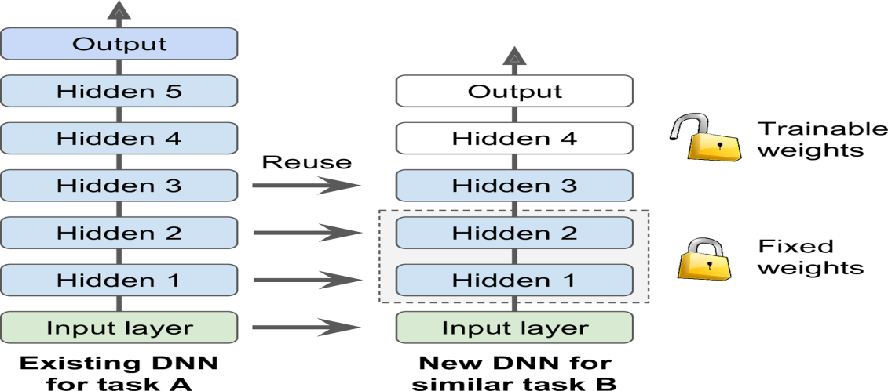
A few more concepts and useful tricks…..
Overview
Gradient Clipping -
A popular technique to lessen the exploding gradients problem is to simply clip the gradients during backpropagation so that they never exceed some threshold (this is mostly useful for recurrent neural networks)This is called Gradient Clipping.8 In general people now prefer Batch Normalization, but it’s still useful to know about Gradient Clipping and how to implement it.
Reusing Pre-trained Layers –
It is generally not a good idea to train a very large DNN from scratch: instead, you should always try to find an existing neural network that accomplishes a similar task to the one you are trying to tackle, then just reuse the lower layers of this network: this is called transfer learning. It will not only speed up training considerably, but will also require much less training data. For example, suppose that you have access to a DNN that was trained to classify pictures into 100 different categories, including animals, plants, vehicles, and everyday objects. You now want to train a DNN to classify specific types of vehicles. These tasks are very similar, so you should try to reuse parts of the first network (see Figure below):
If the input pictures of your new task don’t have the same size as the ones used in the original task, you will have to add a preprocessing step to resize them to the size expected by the original model. More generally, transfer learning will work only well if the inputs have similar low-level features.
Notes:
Training Sparse Models
All the optimization algorithms just presented produce dense models, meaning that
most parameters will be nonzero. If you need a blazingly fast model at runtime, or if
you need it to take up less memory, you may prefer to end up with a sparse model
instead.
One trivial way to achieve this is to train the model as usual, then get rid of the tiny
weights (set them to 0).
Another option is to apply strong ℓ1 regularization during training, as it pushes the
optimizer to zero out as many weights as it can (as discussed in Chapter 4 about Lasso
Regression).
However, in some cases these techniques may remain insufficient. One last option is
to apply Dual Averaging, often called Follow The Regularized Leader (FTRL), a technique
proposed by Yurii Nesterov.17 When used with ℓ1 regularization, this technique
often leads to very sparse models. TensorFlow implements a variant of FTRL called
FTRL-Proximal18 in the FTRLOptimizer class.

Slide 36
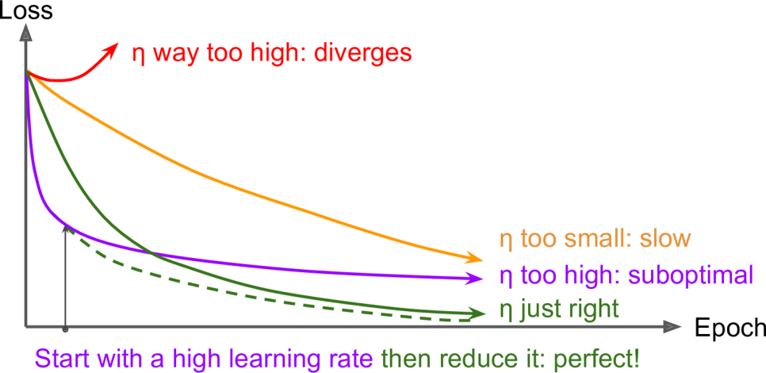
Optimization through Learning Rate Adjustments
Learning Rate Scheduling
Finding a good learning rate can be tricky. If you set it way too high, training may actually diverge. If you set it too low, training will eventually converge to the optimum, but it will take a very long time. If you set it slightly too high, it will make progress very quickly at first, but it will end up dancing
around the optimum, never settling down (unless you use an adaptive learning rate optimization algorithm such as AdaGrad, RMSProp, or Adam, but even then it may take time to settle). If you have a limited computing budget, you may have to interrupt training before it has converged properly, yielding a suboptimal solution.
You may be able to find a fairly good learning rate by training your network several times during just a few epochs using various learning rates and comparing the learning curves. The ideal learning rate will learn quickly and converge to good solution. However, you can do better than a constant learning rate: if you start with a high learning rate and then reduce it once it stops making fast progress, you can reach a good solution faster than with the optimal constant learning rate. There are many different strategies to reduce the learning rate during training. These strategies are called
learning schedules, the most common of which are:
Predetermined piecewise constant learning rate - For example, set the learning rate to η0 = 0.1 at first, then to η1 = 0.001 after 50 epochs. Although this solution can work very well, it often requires fiddling around to figure out the right learning rates and when to use them.
Performance scheduling - Measure the validation error every N steps (just like for early stopping) and reduce the learning rate by a factor of λ when the error stops dropping.
Exponential scheduling - Set the learning rate to a function of the iteration number t: η(t) = η0 10–t/r. This works great, but it requires tuning η0 and r. The learning rate will drop by a factor of 10 every r steps.
Power scheduling - Set the learning rate to η(t) = η0 (1 + t/r)–c. The hyper parameter c is typically set to 1. This is similar to exponential scheduling, but the learning rate drops much more slowly.
Notes:
A 2013 paper19 by Andrew Senior et al. compared the performance of some of the
most popular learning schedules when training deep neural networks for speech recognition
using Momentum optimization. The authors concluded that, in this setting,
both performance scheduling and exponential scheduling performed well, but they
favored exponential scheduling because it is simpler to implement, is easy to tune,
and converged slightly faster to the optimal solution.

Slide 37
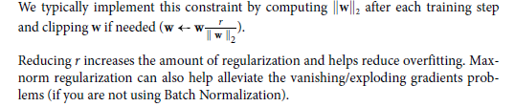
Avoiding Overfitting Through Regularization
Regularization
With four parameters I can fit an elephant and with five I can make him wiggle his
trunk.
—John von Neumann, cited by Enrico Fermi in Nature 427
Deep neural networks typically have tens of thousands of parameters, sometimes even millions. With so many parameters, the network has an incredible amount of freedom and can fit a huge variety of complex datasets. But this great flexibility also means that it is prone to overfitting the training set. With millions of parameters you can fit the whole zoo. In this section we will present some of the most popular regularization techniques for neural networks: early stopping, ℓ1 and ℓ2 regularization, dropout, max-norm regularization, and data augmentation.
Early Stopping - To avoid overfitting the training set, a great solution is early stopping : just interrupt training when its performance on the validation set starts dropping. One way to implement this with Tensorflow is to evaluate the model on a validation set at regular intervals (e.g., every 50 steps), and save a “winner” snapshot if it outperforms previous “winner” snapshots. Count the number of steps since the last “winner” snapshot was saved, and interrupt training when this number reaches some limit (e.g., 2,000 steps). Then restore the last “winner” snapshot. Although early stopping works very well in practice, you can usually get much higher performance out of your network by combining it with other regularization techniques.
ℓ1 and ℓ2 Regularization - Just like you did for simple linear models, you can use ℓ1 and ℓ2 regularization to constrain a neural network’s connection weights (but typically not its biases)
Drop-out – We have already introduced the concept in a previous slide.
Max-Norm Regularization - Another regularization technique that is quite popular for neural networks is called max-norm regularization: for each neuron, it constrains the weights w of the incoming connections such that ∥ w ∥2 ≤ r, where r is the max-norm hyper parameter and ∥ ・ ∥2 is the ℓ2 norm.

Slide 38
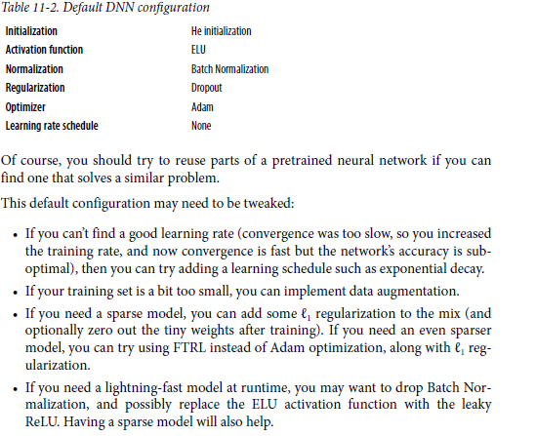
Some Practical guidelines ….
What to do……

Slide 39
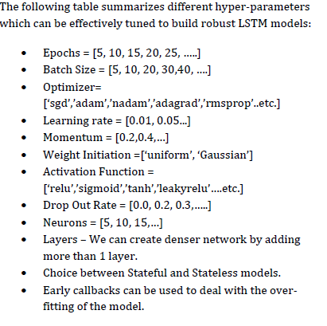
A broad list of hyper – parameters for DNN
Hyper-parameters

